Slide 1

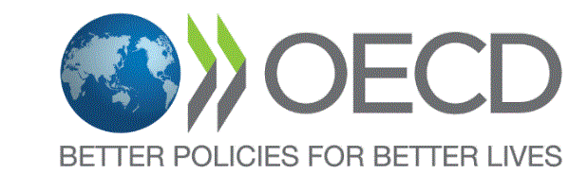
PISA
Programme for International Student Assessment
Restricted Use - À usage restreint

Slide 2

What is PISA?
Conducted by the Organisation for Economic Co-operation and Development (OECD), the Programme for International Student Assessment (PISA) is the largest international comparative education programme in the world. Since PISA began in 2000, more than 100 countries and economies have participated in the programme, including 50 middle-income countries.
Through participation in PISA, countries become part of a global community. PISA is also one of the primary sources of data for the United Nations and its member states in monitoring progress towards the achievement of the Education Sustainable Development Goal by 2030.
PISA 2029 will be the 10th edition of PISA.
© OECD 2025
Restricted Use - À usage restreint

Slide 3




15
Year olds,
PISA evaluates how well students can use their knowledge and skills to tackle new challenges and practical, real-world situations
Grades
7+
PISA tests 15-year-old students in grades 7 and above. Students complete a two-hour test in:
    reading,
    mathematics,
    science and
    an innovative domain that targets interdisciplinary skills.
For PISA 2029:
    The focal domain is reading
    The innovative domain is media and artificial intelligence literacy.
PISA shows how learning relates to demographic, social and economic aspects. With reliable data on gaps in access and differences in outcomes between groups of students, countries can determine whether all students are given equal opportunities to succeed at school and beyond.
© OECD 2025
Restricted Use - À usage restreint

Slide 4

PISA collects data on students, schools and systems:
      Students complete a 35-minute questionnaire on their background, well-being, learning strategies, attitudes towards reading and motivation.
      School principals and system leaders provide data on school policies, practices, resources and institutional factors that help explain performance differences.
PISA adapts to different countries’ needs:
      PISA is a computer-based assessment that is adaptive and appropriate for both low- and high-performing students.
      There is an online and offline version of the survey available to the students.
© OECD 2025
Restricted Use - À usage restreint

Slide 5
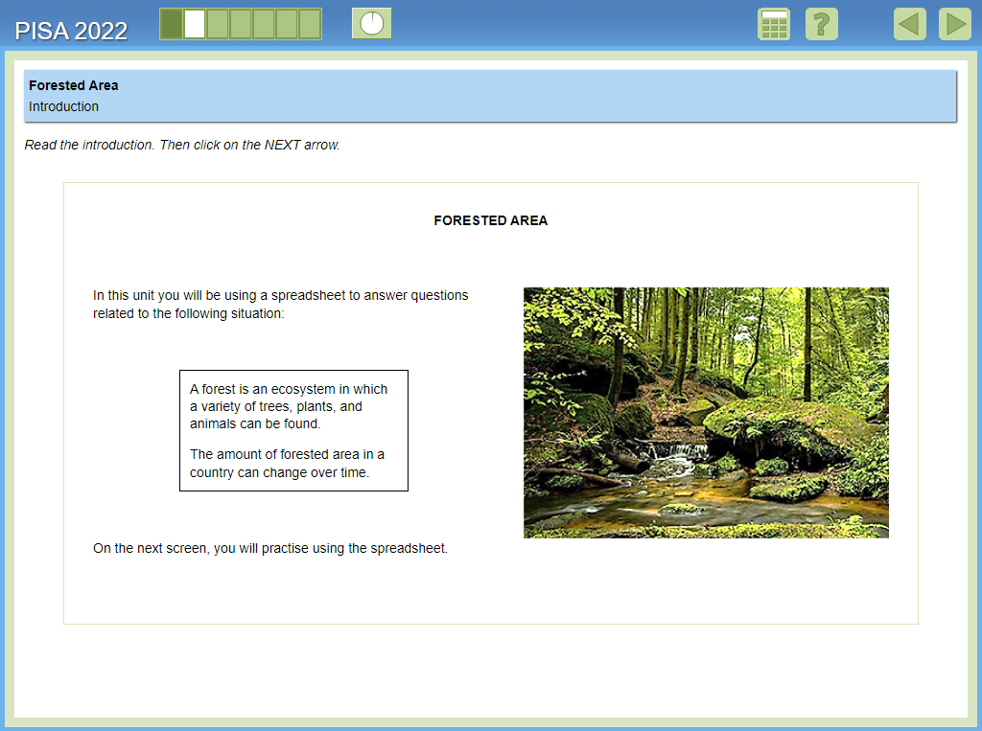
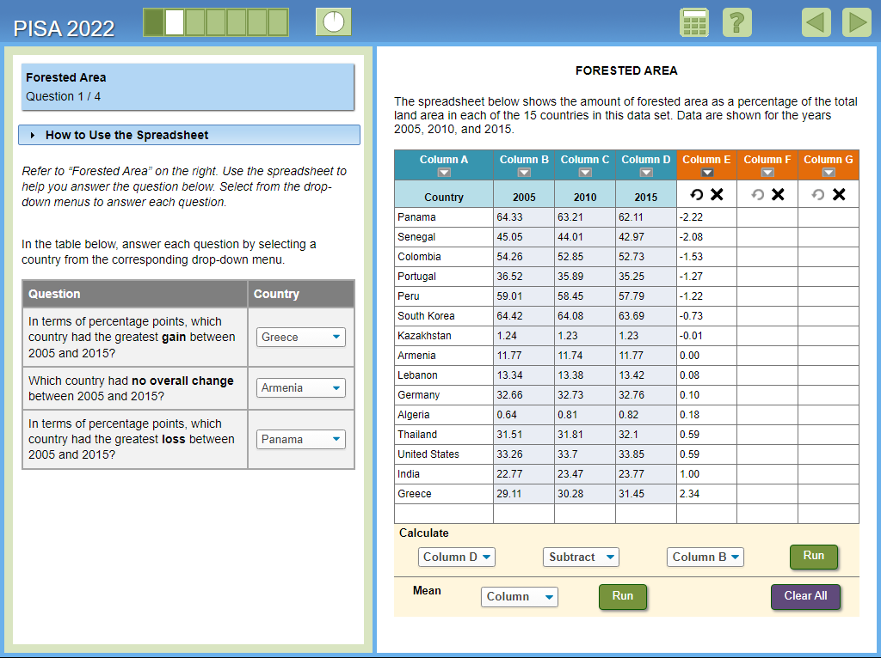
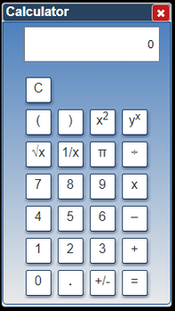
PISA item examples
Students need to determine what calculation(s) to perform, how to use the spreadsheet to perform them, and lastly interpret the results with respect to the context.
Calculator and “Help” buttons are available to students at the top of each screen if needed.
© OECD 2025
Restricted Use - À usage restreint

Slide 6
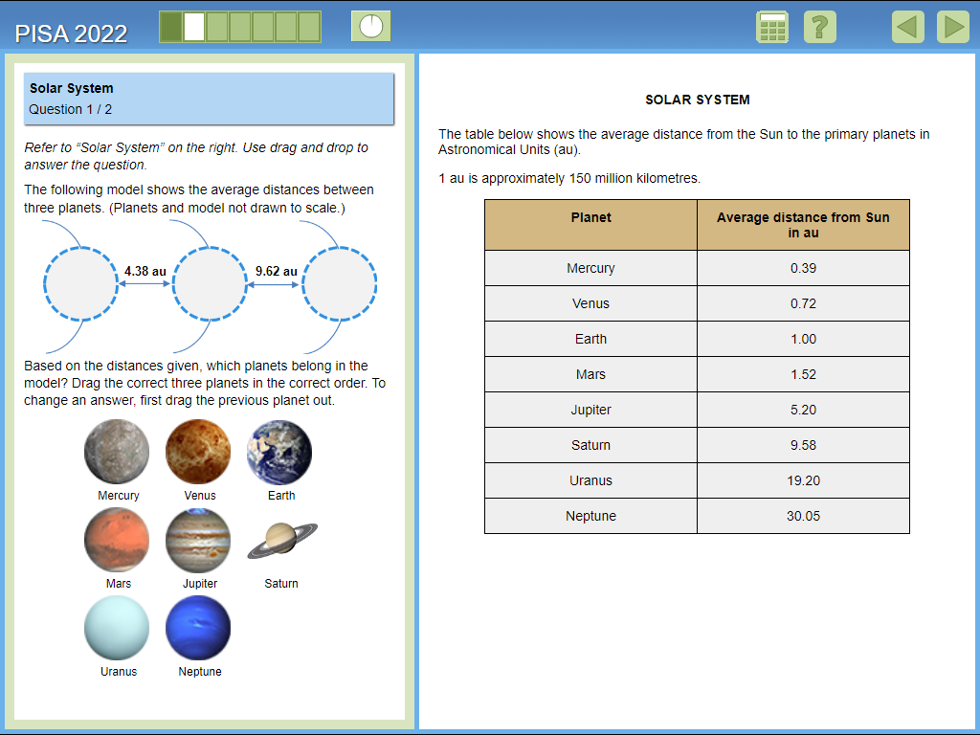
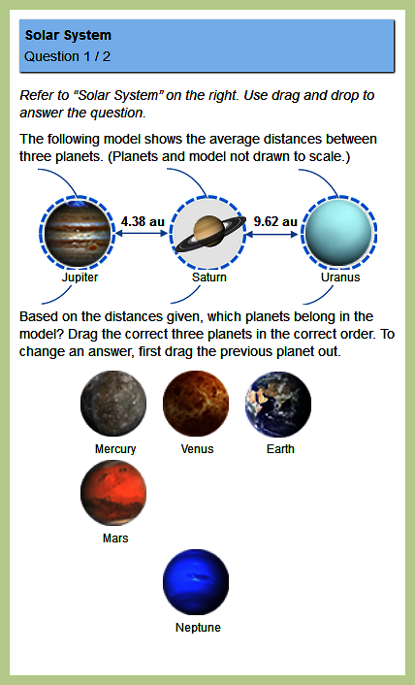
PISA item examples
Below is an image of what the question stem and response area look like after the student has dragged-and-dropped the planets into their respective locations in the model.
For more PISA items, please consult our website:
https://www.oecd.org/en/about/programmes/pisa/pisa-test.html
© OECD 2025
Restricted Use - À usage restreint

Slide 7
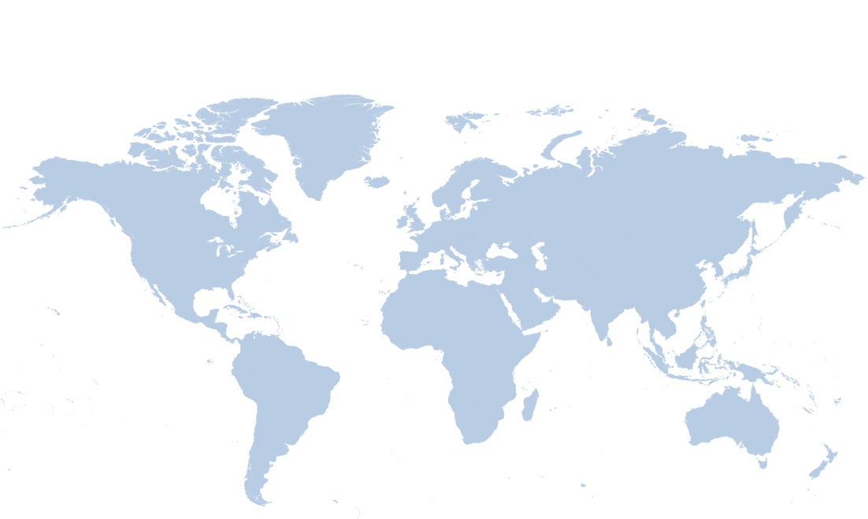
Albania
Algeria
Argentina
Armenia
Australia
Austria
Azerbaijan
Belarus
Belgium
Bosnia and Herzegovina
Brazil
Brunei Darussalam
Bulgaria
Cambodia
Canada
Chile
China
Chinese Taipei
Colombia
Costa Rica
Croatia
Czechia
Denmark
Dominican Republic
Ecuador
Egypt
El Salvador
Estonia
Finland
France
Georgia
Germany
Ghana
Greece
Guatemala
Honduras
Hong Kong (China)
Hungary
Iceland
India
Indonesia
Ireland
Israel
Italy
Jamaica
Japan
Jordan
Kazakhstan
Kenya
Korea
Kosovo
Kurdistan Region (Iraq)
Kyrgyzstan
Latvia
Lebanon
Lithuania
Luxembourg
Macao (China)
Malaysia
Malta
Mauritius
Mexico
Moldova
Mongolia
Montenegro
Morocco
Netherlands
New Zealand
North Macedonia
Norway
Palestinian Authority
Panama
Paraguay
Peru
Philippines
Poland
Portugal
Qatar
Romania
Russian Federation
Rwanda
Saudi Arabia
Senegal
Serbia
Singapore
Slovak Republic
Slovenia
Spain
Sweden
Switzerland
Tajikistan
Thailand
Trinidad & Tobago
Tunisia
Türkiye
Ukraine
United Arab Emirates
United Kingdom
United States
Uruguay
Uzbekistan
Venezuela
Viet Nam
Zambia
PISA participants
For more information about years
of participation and national
coverage, please consult our website: https://www.oecd.org/en/about/programmes/pisa/pisa-participants.html
© OECD 2025
Restricted Use - À usage restreint
Restricted Use - À usage restreint

Slide 8

This work is published under the responsibility of the Secretary-General of the OECD. The opinions expressed and arguments employed herein do not necessarily reflect the official views of OECD member countries.
This document, as well as any data and any map included herein, are without prejudice to the status of or sovereignty over any territory, to the delimitation of international frontiers and boundaries and to the name of any territory, city or area.
The statistical data for Israel are supplied by and are under the responsibility of the relevant Israeli authorities. The use of such data by the OECD is without prejudice to the status of the Golan Heights, East Jerusalem and Israeli settlements in the West Bank under the terms of international law.
Photo credits: Cover © Xavier Lorenzo/Shutterstock.com.
© Monkey Business Images/Shutterstock.com; © Backgroundy/Shutterstock.com; © epicurean/iStockphoto.com; © SDI Productions/iStockphoto.com; © Ground Picture/Shutterstock.com; © PeopleImages.com – Yuri A/Shutterstock.com; © Soumaya Maghnouj/OECD; © Drazen Zigic/Shutterstock.com.
Icon credits: © Flaticon.com with contributions from Freepik, Eucalyp, Shin_icons, Kerismaker, Smashicons, Becris, Grafixpoint and SBTS2018.
© OECD 2025
Attribution 4.0 International (CC BY 4.0)
This work is made available under the Creative Commons Attribution 4.0 International licence. By using this work, you accept to be bound by the terms of this licence (https://creativecommons.org/licenses/by/4.0/).
Attribution – you must cite the work.
Translations – you must cite the original work, identify changes to the original and add the following text: In the event of any discrepancy between the original work and the translation, only the text of original work should be considered valid.
Adaptations – you must cite the original work and add the following text: This is an adaptation of an original work by the OECD. The opinions expressed and arguments employed in this adaptation should not be reported as representing the official views of the OECD or of its Member countries.
Third-party material – the licence does not apply to third-party material in the work. If using such material, you are responsible for obtaining permission from the third party and for any claims of infringement.
You must not use the OECD logo, visual identity or cover image without express permission or suggest the OECD endorses your use of the work.
Any dispute arising under this licence shall be settled by arbitration in accordance with the Permanent Court of Arbitration (PCA) Arbitration Rules 2012. The seat of arbitration shall be Paris (France). The number of arbitrators shall be one.

Slide 9

PISA is organised by the Organisation for Economic Co-operation and Development (OECD). The OECD is an international organisation that works to build better policies for better lives. We draw on more than 60 years of experience and insights to shape policies that foster prosperity and opportunity, underpinned by equality and well-being.
We work closely with policy makers, stakeholders and citizens to establish evidence-based international standards and to find solutions to social, economic and environmental challenges. From improving economic performance and strengthening policies to fight climate change to bolstering education and fighting international tax evasion, the OECD is a unique forum and knowledge hub for data, analysis and best practices in public policy. Our core aim is to set international standards and support their implementation – and help countries forge a path towards stronger, fairer and cleaner societies.

